Slide 1
Introduction to Morphology

Slide 2
Morphology
Wordformation
Inflection
Derivation
Compounding
Affixation
Other
1or2 free roots
redup conversion
prefix suffix infix
+/- class-changing

Slide 3
Lexicon
Word
Morphology
Word as the smallest free form that appears in a language
What are those things in the tree? Birds.
Qu'est-ce que c'est que ça?
Des oiseaux.
Not: *Oiseaux.

Slide 4
Lexeme (lemma)
We can begin with a rough conception of forms that a word can take on while still being the same word --
One entry in the dictionary for sing, sang, sung, another for singer.
Alternate forms of the same lexeme are formed by inflectional morphology; if there is a common (fixed) form, it’s called the inflectional stem.

Slide 5
Derivational morphology
Forms new words (new lexemes) from other words. Typically, the meaning changes. (When does it not? No problemo! )
The change in meaning can be subtle, difficult to make explicit; conditions on the base may be complex; each suffix has its history --
Unlike the case of inflectional morphology.

Slide 6
Morpheme: smallest unit of language that carries information about meaning or function:
build; build-er; house; houses.

Slide 7
Are we saying that a morpheme must have a characterizable meaning?
No. But that is the usual case, without a doubt.

Slide 8
Grammatical vs lexical morphemes
When we can identify a word (or a part of a word) as being a morphological constituent and being composed of two morphemes,
we can identify one of them as the base and the other the affix.
Except when…. (compounds, reduplication, …)

Slide 9
Lexical morpheme
When a word consists of one morpheme, it is a lexical morpheme.
When it consists of two morphemes, it is the base: that which is not the affix.

Slide 10
Derivational morphology
Deals with the relationship between morphologically simple forms -- roots -- and more complex forms which are distinct lexemes.

Slide 11
monomorphemic (simple) words; complex or polymorphemic words.
no natural connection between sound and meaning (??)
Free morpheme: can stand as a word by itself
Bound morpheme: cannot.

Slide 12
Allomorphs: a single morpheme with more than one phonological realization. say/sez. a/an. Often the result of history of the language.

Slide 13
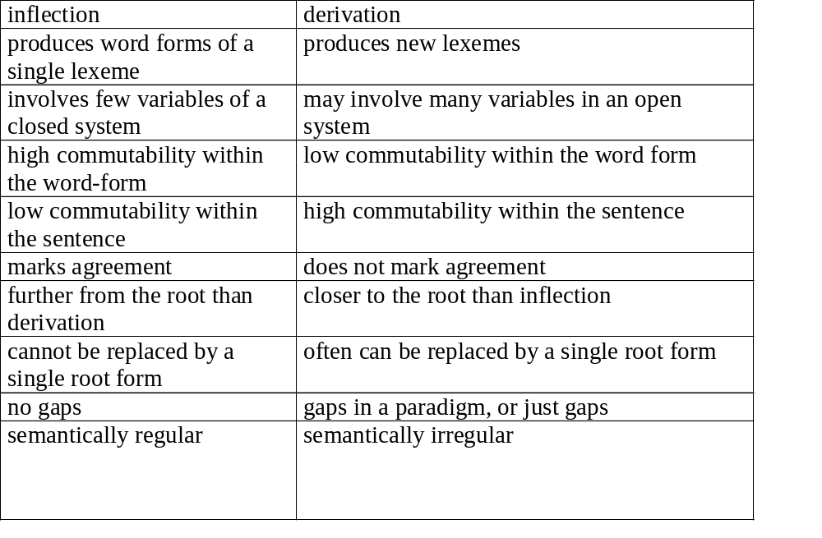

Slide 14
Terms:
Bound morpheme, free morpheme
base plus affix
root
inflectional versus derivational:
ODA: same word; change/not change category or "type of meaning";
order: derivational before inflectional
productivity
regularity of form?

Slide 15
stem = word + inflection
semantically transparent versus opaque
compounds: 2 stems: endocentric (normal vs
exocentric (redskin, highbrow, Maple Leafs)
?Sino-Soviet, Howard Johnson (John Goldsmith) Anglophobe
upgrades of affixes to stems: emic, etic, ese, ism.
Baby sitter, ice breaker, cake-icer, lawn-mower, star-gazer
5 footer

Slide 16
Roots and affixes: complex words consist often of a root plus affixes. Prefixes, suffixes. The category of the word may be determined by either -- though it's typically the affix, not the base.

Slide 17
List prefixes in English: p. 129: Prefixes and suffixes. Associated with categories (in input and in output: suffixes change category): -able suffix.

Slide 18
Derivational versus Inflectional Morphology

Slide 20
From Aronoff:
Assume English stress rule is Latin stress rule -- penult or antepenult. inexplicable hospitable explicable despicable formidable

Slide 21
Two forms: comparable comparable réparable repairable réfutable refútable préferable preférable

Slide 22
circumscribe circumscriptible circumscribable extend extensible extendable defend defensible defendable perceive perceptible perceivable divide divisible divdable deride derisible deridable

Slide 23
Truncation:
tolerate tolerable *toleratable
negotiate negotiatable *negotiatable
vindicate vindicable *vendicatable
demonstrate demonstrable *demonstratable
exculpate exculpable *exculpatable
but
debate debatable *debable

Slide 24
infixes: fuckin' in English; others in Tagalog:
takbuh: t-um-akbuh run/ran
lakad l-um-akad walk/walked
pili? p-in-ili? choose/chose

Slide 25
Arabic intercalation:
katab 'write'
kutib 'have been written'
aktub 'be writing'
uktab 'being written'

Slide 26
Cliticization: short unstressed forms that 'lean on' a neighboring word:
I'm leaving now
Mary's going to succeed
They're here now.

Slide 27
Je ne le crois pas.

Slide 28
Internal change: relating allomorphs: run/ran; sing/sang/sung.

Slide 29
Nouns: often marked for :
.number
.possessor
.case
.gender

Slide 30
verbs:
subject agreement
object agreement
tense, aspect

Slide 31
adjectives:
agreement with object referred to for number, case, gender
degree of comparison (-er, -est)

Slide 32
1.ninasema 8. wanasema
2. wunasema 9. ninapika
3. anasema 10. ninaupika
4. ninaona 11. ninakupika
5. ninamupika 12. ninawapika
6. tunasema 13. ananipika
7. munasema 14. ananupika
Swahili (from Nida’s workbook)

Slide 33
15. nilipika 25. wutakanipikizwa
16. nilimupika 26. sitanupika
17. nitakanupika 27. hatanupika
18. nitakapikiwa 28. hatutanupika
19. wutakapikiwa 29. hawatatupika
20. ninapikiwa
21. nilipikiwa
22. nilipikaka
23. wunapikizwa
24. wunanipikizwa

